Slide 1
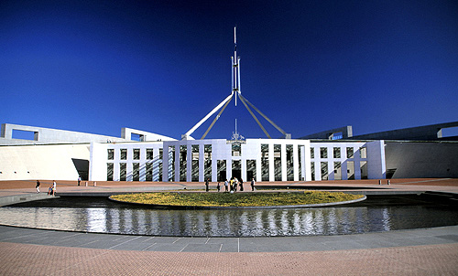
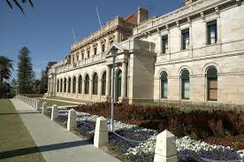

Making a law in parliament

Slide 2
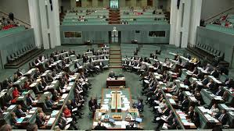
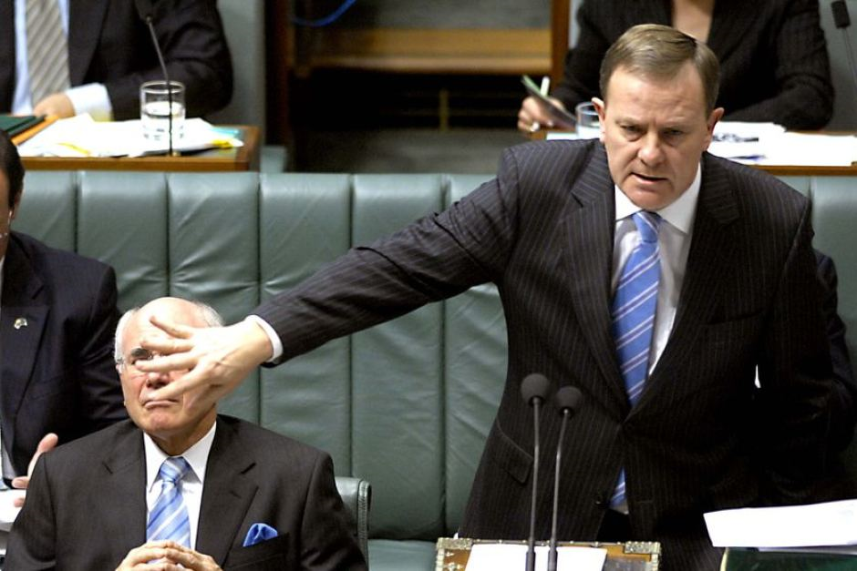
Introduction
A bill is a proposed law that needs to pass through both houses of Parliament before it becomes law.

Slide 3
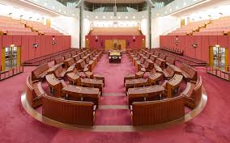
RECALL!
What are the names of the two houses of Federal Parliament?

Slide 4
Glossary
Bill: A proposal for a new law.
Governor General: The Queen’s representative in Australia.
Speaker: A member of the House of Representatives chosen by other members to run meetings of the House and to make sure the standing orders (parliamentary rules) are followed.

Slide 5
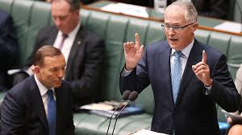
Watch the following clip on the process of a bill through to a law in federal parliament.
http://splash.abc.net.au/home#!/media/29457/passing-a-bill-in-parliament

Slide 6
Making a law flowchart
Read through the fact sheet on making a law in Federal Parliament.
In pairs create your own flowchart on A3 paper – include information for each stage and a title

